Slide 1
GW Data Workshop
Data Story Telling
February 21st, 2017

Slide 2
What does it mean to “tell a story” with data?

Slide 3


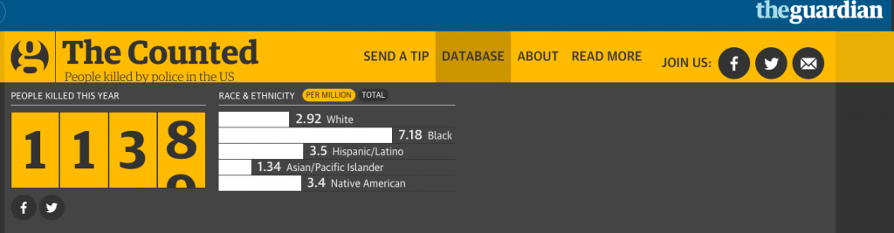
Data Journalism

Slide 4
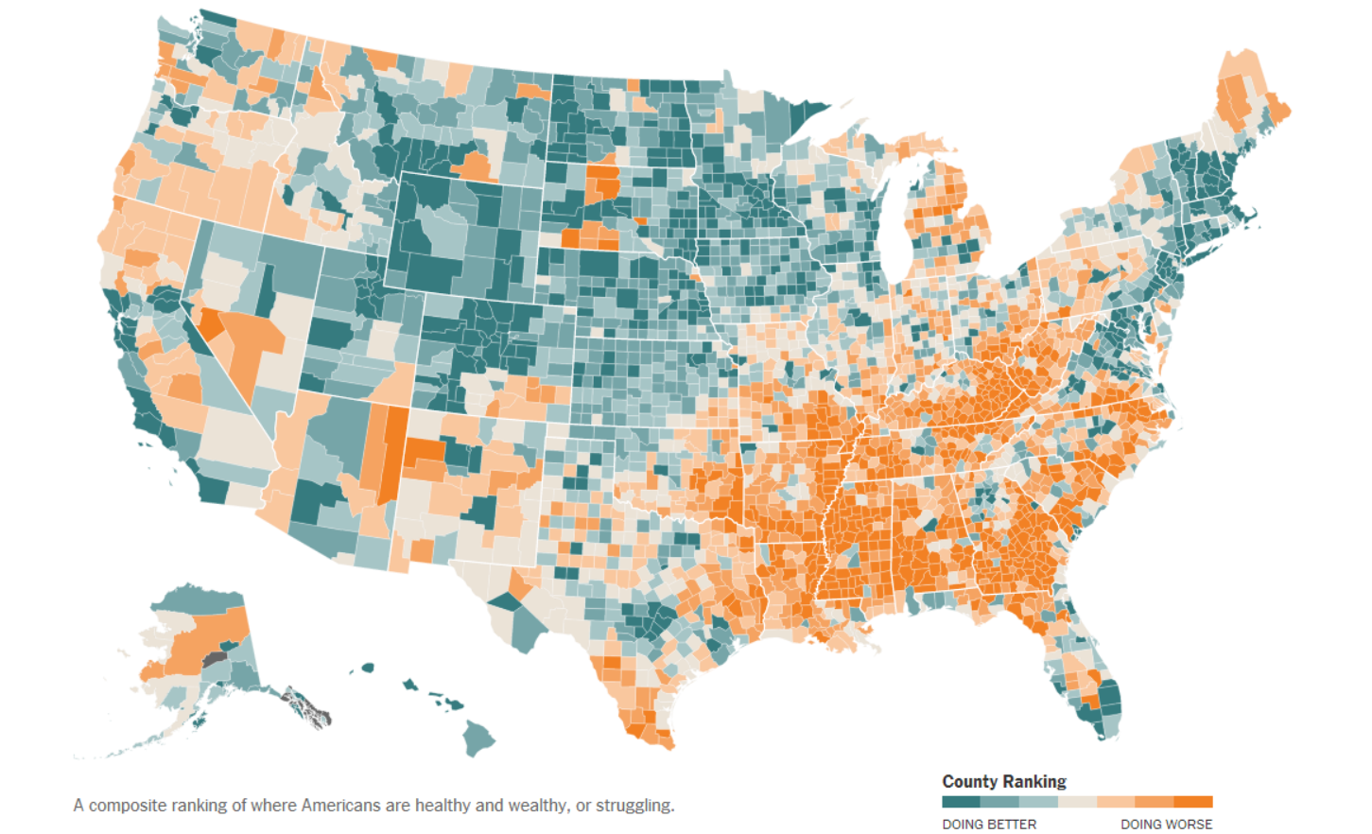

Slide 5
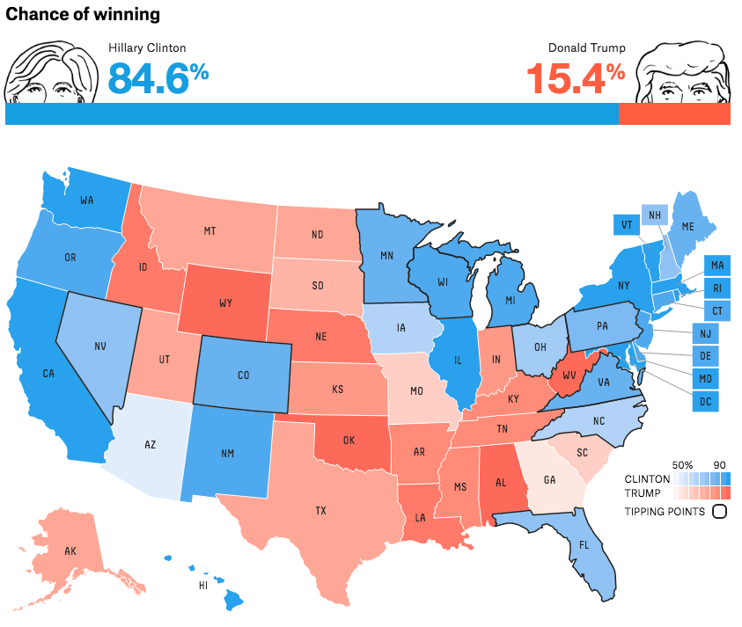

Slide 6


Business Analytics

Slide 7

About
Statistical programming language
Great for data analysis, predictive modeling, and data viz
Completely free!
Better than Python

Slide 8

How do I even use R?
First, you must install it
https://cran.r-project.org/
Ok now what?
You need an IDE (Integrated Development Environment)
RStudio!
https://www.rstudio.com/
RStudio is where you will write R code
User-friendly way to run R
There are other IDE’s, but not using RStudio is just plain weird

Slide 9
A few data types
Vectors:
The most basic data type in R
A collection of data elements
Factors:
Created from vectors
Stores the vector and each distinct type as a label
Data frames:
Tabular objects consisting of columns and rows (tables, Excel spreadsheets, etc.)
Others include:
Arrays
Matrices
Lists

Slide 10
A few more R things
Indexing/Looping:
Unlike most programming languages, R begins “counting” at 1 instead of zero
This is just how normal people count. Every other programming language is wrong.
Example: x <- c(1,7,3,8)
X[1] = 1
X[2] = 7
In other languages, x[0] would be the first element (1). But R is diffeRent.

Slide 11
Data Viz Guidelines
The best visualizations are simple, neat, and to the point
Overly complicated visualizations are a pain to look at
NO PIE CHARTS
Seriously, just no
NO 3D PIE CHARTS
For the love of god, no
That’s about it
And don’t use Excel

Slide 12
Demo!

Slide 13
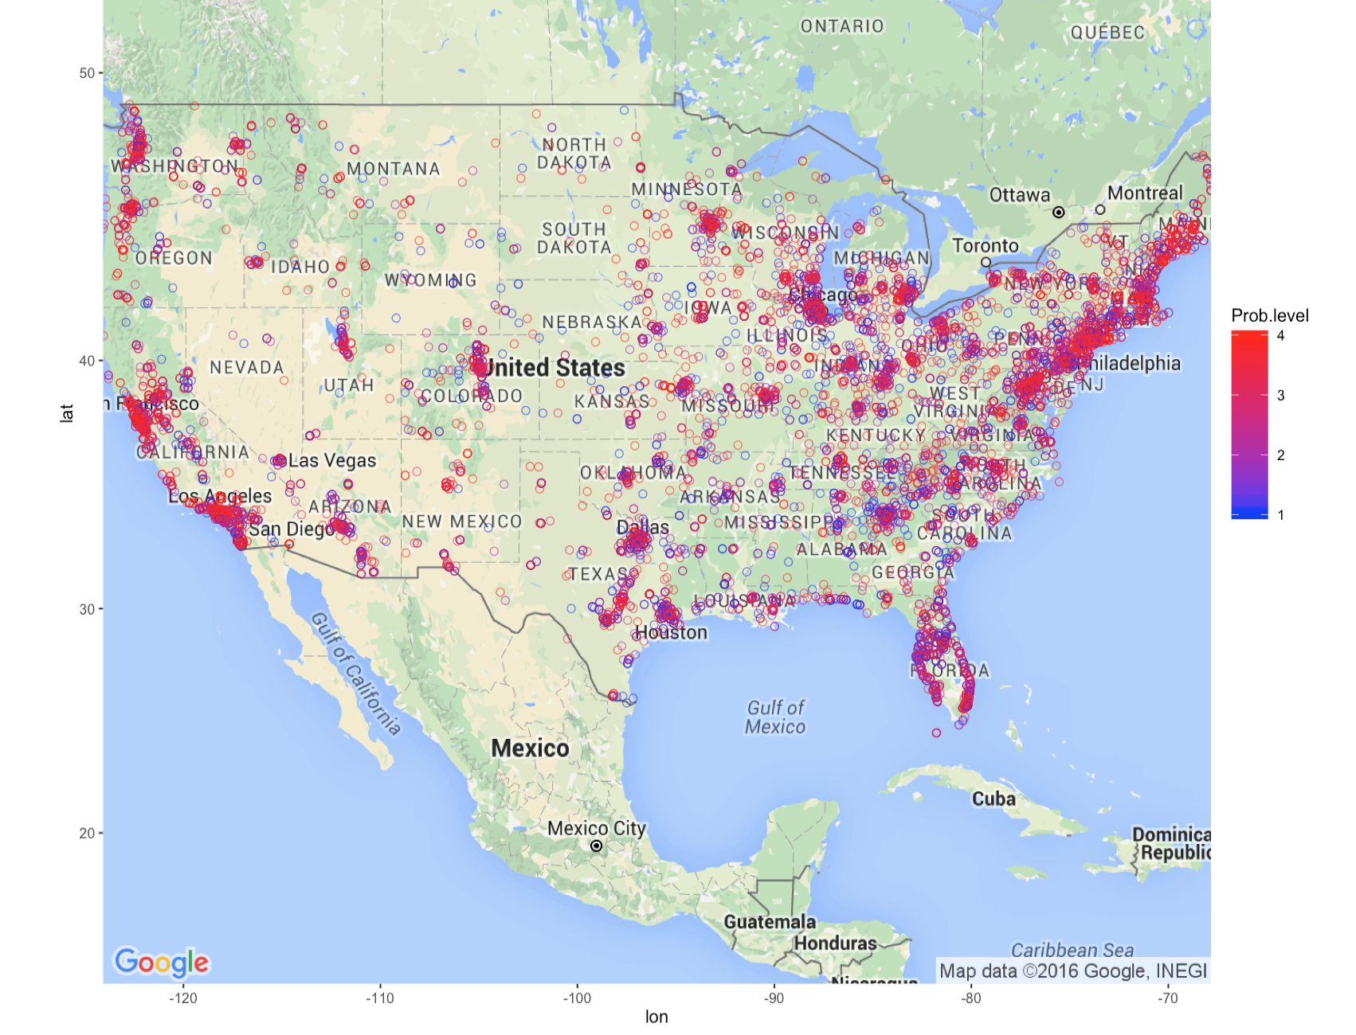
Some visualizations I’ve done

Slide 14
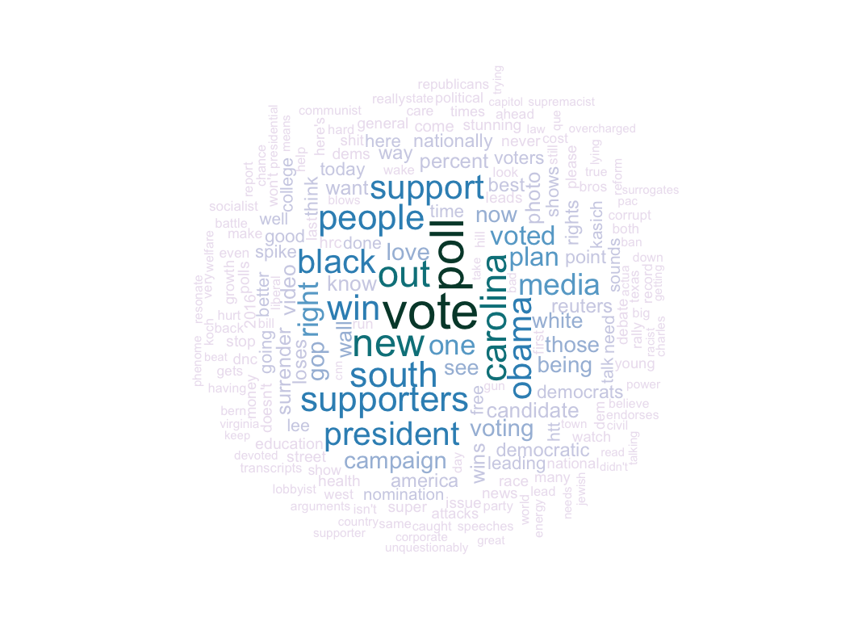
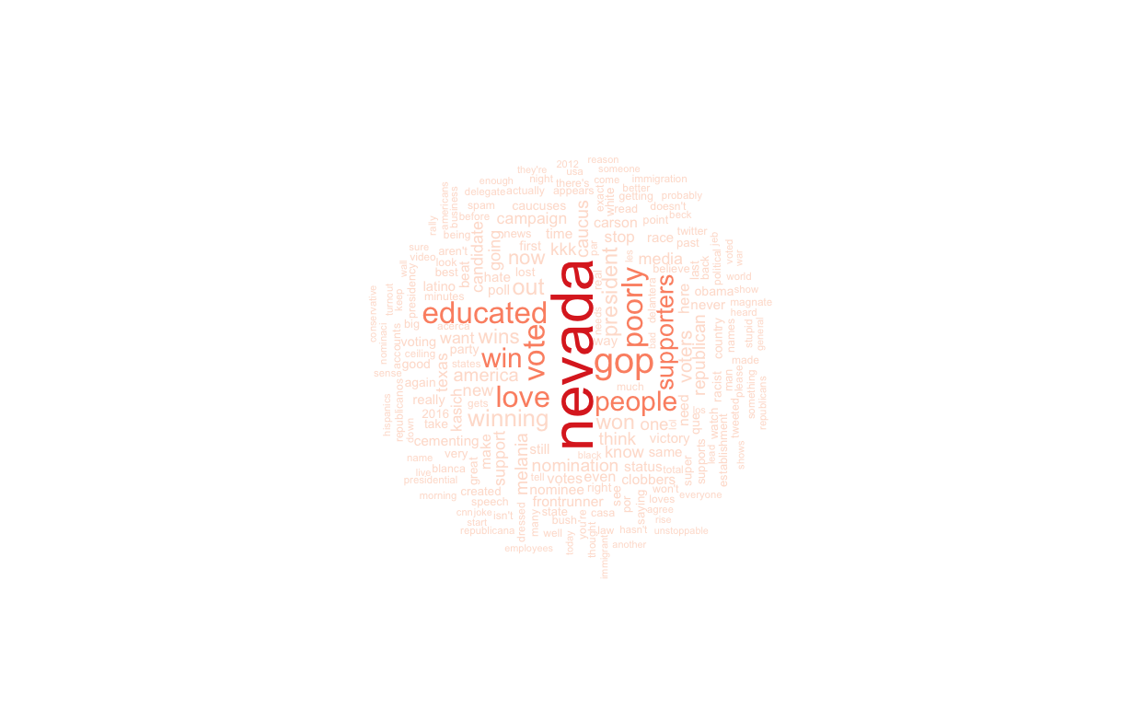
Some visualizations I’ve done

Slide 15
Thanks for coming!
Questions? Comments?

